Slide 1

Quant Week 0
9/4/25
Notes:
Complete

Slide 2
https://www.youtube.com/watch?v=FoYC_8cutb0

Slide 3
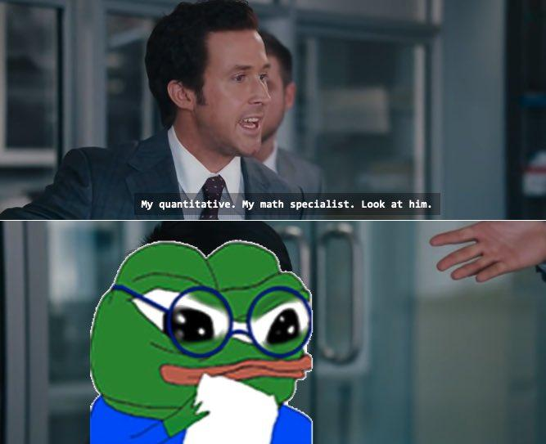

Slide 4

Agenda
Introductions
QT Prep
Semester Overview
Projects

Slide 5
Introductions
General Introduction
Name
Year
Major(s)
Where you’re from
Fun Fact

Slide 6
Sequence One
88 8 80 10 70 15 ?
Notes:
88 - 8 80 -10 70-15

Slide 7
Sequence Two
1/2 , 3/2, 3/4, 5/4, 5/6, ?
Notes:
Zig zag 1->2, 2->3, 3->4, 4->5, 5->6 2->3, 3->4, …..

Slide 8
Sequence Three
2, 3, 6, 1/2, 3, 1/6, ?
Notes:
2x3 6x1/2
3x1/6

Slide 9
Semester Overview

Slide 10
Semester Overview
Education
Trading Strategies
Market Making
High Frequency Trading
Interview Prep
Options Theory
Events
Insider Trading Game
Jane Street Puzzle
Game Theory Poker Class
Market Making Game
Projects
Notes:
2x3 6x1/2
3x1/6

Slide 11
Projects

Slide 12
Projects
Reinforcement Learning
Develop a trading algorithm using Reinforcement Learning. Last semester, I built an algo with another machine learning model: Random Forest!
Gamma Scalper
Opportunity to learn about Options and Algorithmic trading. Gamma Scalping will be discussed in a future lecture.
Kraken Live trading
Integrate an elementary trading algorithm with Kraken’s API to autonomously place live trades

Slide 13
Projects
Machine Learning
Use ML to predict pairs trading opportunities
Deep Learning
Use LSTM or Transformer networks to detect nonlinear relationships in statistical arbitrage

Slide 14
Demo

